Slide 1
SLSVIEW
Supply Chain Visibility Powered by SLSVIEW
Notes:
Notes:
Gaps:
1. Wording around best-in-class RFID solution
2. Better graphics: better designer graphics – Pass through @Dave
3. Slide focused on Supply chain visibility callout: zoom out of application -> piece of apparel – scan at the tunnel, cycle count, shipment verification. - Digital DNA

Slide 2
Levata
RFID AUTOMATION SOLUTIONS
Supply Chain Visibility Solution
SLS
Global Food & Goods Retailer
Proven Transformation Partner
A Complete Supply Chain Visibility Solution
Levata delivers the technology to enable mobility, automation, and visibility, the expertise to connect people, data, and assets, and the insights to shift from day-to-day management to driving what’s next.
SLS, a Levata-acquired solution, delivers AI-powered supply chain visibility automation using RFID for end-to-end visibility from manufacturing and warehouse distribution to retail environments
Labor productivity improvement
25%
Number of sites deployed
20
800+
Shipment Verification Automation
No-Touch Receiving Verification
Cycle Counting
Pallet Verification
Case Content Verification
Point of Sale
Employees Globally
Annual Savings
$35M
84%
ROI
7 Months
Fortune 500 Served

Slide 3
SLS Solutions Throughout the Value Chain
Manufacturing
Warehousing
Retail Store
C. Shipment Verification Automation Fully automated no-touch DC shipment content verification at the dock door. (No manual scanning)
C. Pallet Verification​ Verify pick accuracy and aggregation of the pallet​
B. Cycle Counting Full warehouse automated cycle counting & Inventory visibility​ in minutes instead of weeks
A. Automated Receiving Verification Receipt and validation of delivery to the store
C. Point of Sale Automated checkout at POS
C
A
B
B
B
A
C
C
D
A
A. RFID Enablement Encoding of product post-manufacturing
B. Case Content Verification Case content verification on an assembly line without opening It
A. No Touch Receiving Verification Autonomous scanning and aggregation of product to DC Inventory ​
D. Shipment Verification Automation​ Verify the pallet is on the proper shipment to the correct store and it’s content without scanning individual cases.
B. Cycle Counting Automated counting of on-hand inventory to the store in minutes
‒ 3
Notes:
A header that SLS manage solution works across the value chain

Slide 4
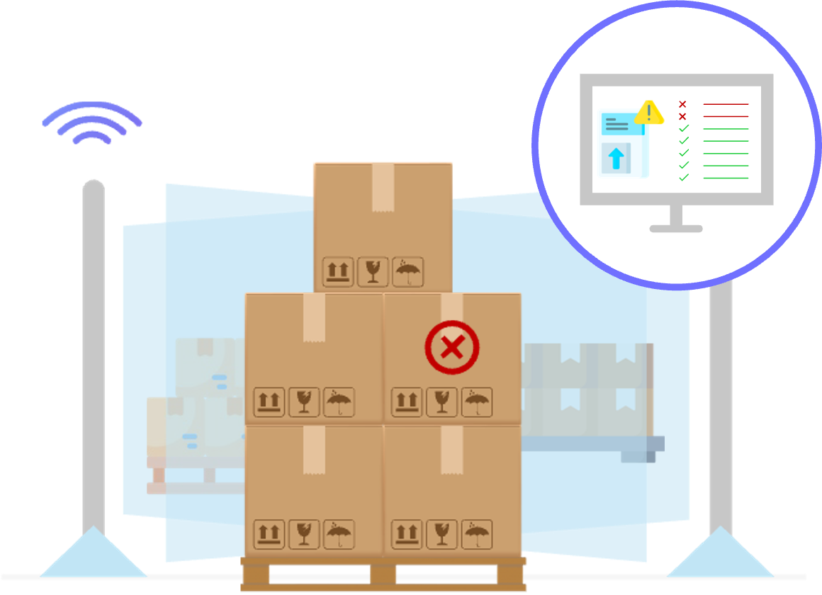
Supply Chain Visibility Solution
Automate with Accuracy
SLS devices boast patented antenna technology for top-performing RFID reads, ensuring industry-leading capture accuracy with SLS Manage operating system.
Unlock and Act on Supply Chain Insights
AI-powered SLS View provides actionable insights for operators and managers. Integrates with any WMS/ERP and other visibility softwares.
SLS Manage
Devices
AI-Powered
SLS View
SLS Tags
AND / OR
AND / OR
Maximize Consistency and Performance
Proprietary, purpose-built SLS Tags designed specifically for SLS Solutions that outperform industry-standard tags to realize optimal performance.
3rd party
WES / WCS
3rd party
Tags
Notes:
Change Title Style
Combine the text on left to right (reduce the text on right)

Slide 5
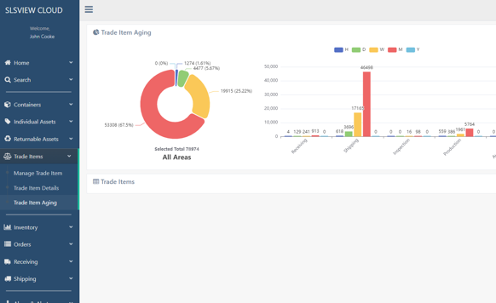
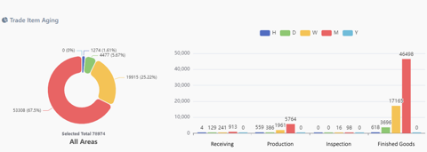
SLSVIEW software
Industry Leading Software to Unlock Actionable Insights Throughout Your Supply Chain
End-to-End supply chain visibility with actionable insights
Realtime inventory visibility
Simplified integration with GS1 electronic product code information standards (EPCIS)
Industry leading read accuracy with proprietary on-reader solution
Cloud-based software that integrates into your ERP/WMS for improved management and reporting

Slide 6
Real-time, Actionable Insight Throughout Your Supply Chain
RFID AUTOMATION SOLUTIONS
6

Slide 7
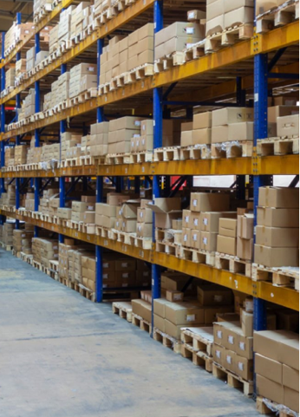
End-to-End Visibility Across Your Value Chain
RFID AUTOMATION SOLUTIONS
Receiving
Production
Storing
Packaging
Shipping

Slide 8
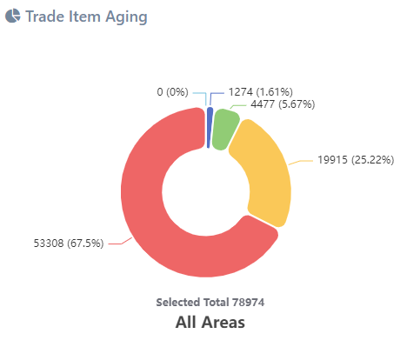
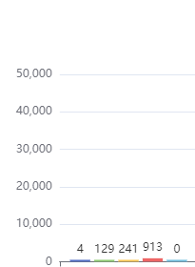
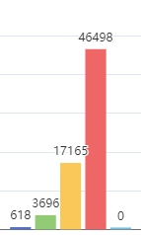
RFID AUTOMATION SOLUTIONS
End-to-End Visibility Across Your Value Chain
Receiving
Production
Inspection
Finished Goods

Slide 9
RFID AUTOMATION SOLUTIONS
Without a Purpose-Built RFID Cloud Software, You Observe:
Poor RFID read behavior and
performance
Multi-vendor delivery and coordination
Non-scalable identification standard
High integration costs and lengthy project timelines
9
Notes:
“Companies adopt RFID but don’t observe its full potential”

Slide 10
RFID AUTOMATION SOLUTIONS
Enable Supply Chain Visibility with SLSVIEW
Enhance RFID read behavior and performance
One stop shop for end-to-end RFID Solutions
Easy to scale and deploy software
Low cost, rapid plug and play integration
10
Notes:
“Companies adopt RFID but don’t observe its full potential”

Slide 11
Workflows
RFID AUTOMATION SOLUTIONS
11

Slide 12
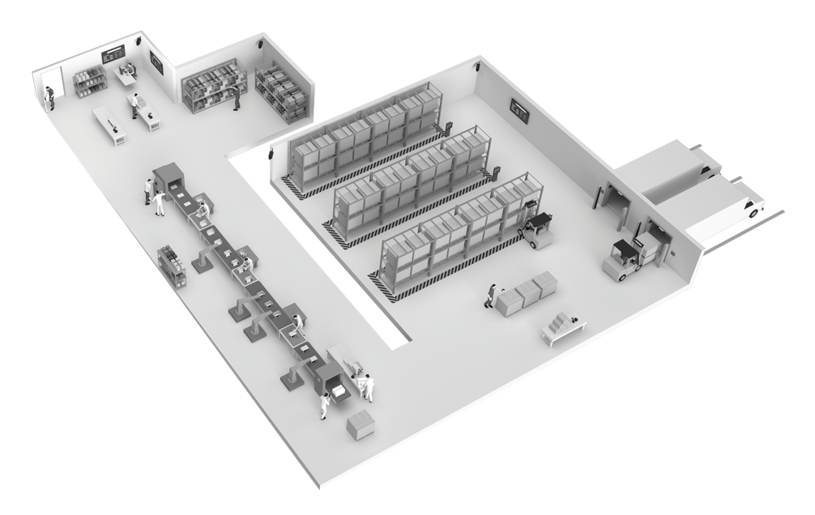
RFID Automation Workflows Powered by SLSVIEW
RFID AUTOMATION SOLUTIONS
1. Print with Serialized Identification
Electronic product code tag encoding and printing
2. Order Fulfillment Verification
Automated content verification without manual staging and unboxing
3. Inventory Management
End-to-end inventory visibility with automated cycle counting in minutes
1
4
3
4. Returnable Container Tracking
Asset visibility across suppliers, manufacturers, distributors, and customers
2
5
5. Shipment Verification
Automated shipping and customer-receiving tracking

Slide 13
1. Print with RFID
RFID AUTOMATION SOLUTIONS
Electronic Product Code Serialized Identification Tags
Best in Class
Global Identification Strategy
GS1 Tag Data Standard (TDS) compliant encoding
Encoding
For items, assets, containers, returnables, and shipments
Common Business Vocabulary
For integration across the supply chain with consistent messaging standard
Agnostic Identification Platform
Use multiple technologies including human-readable for tracking
Interoperability between the RFID Electronic Product Code and Barcode
On-demand and batch encode and print as early as point of manufacturing

Slide 14
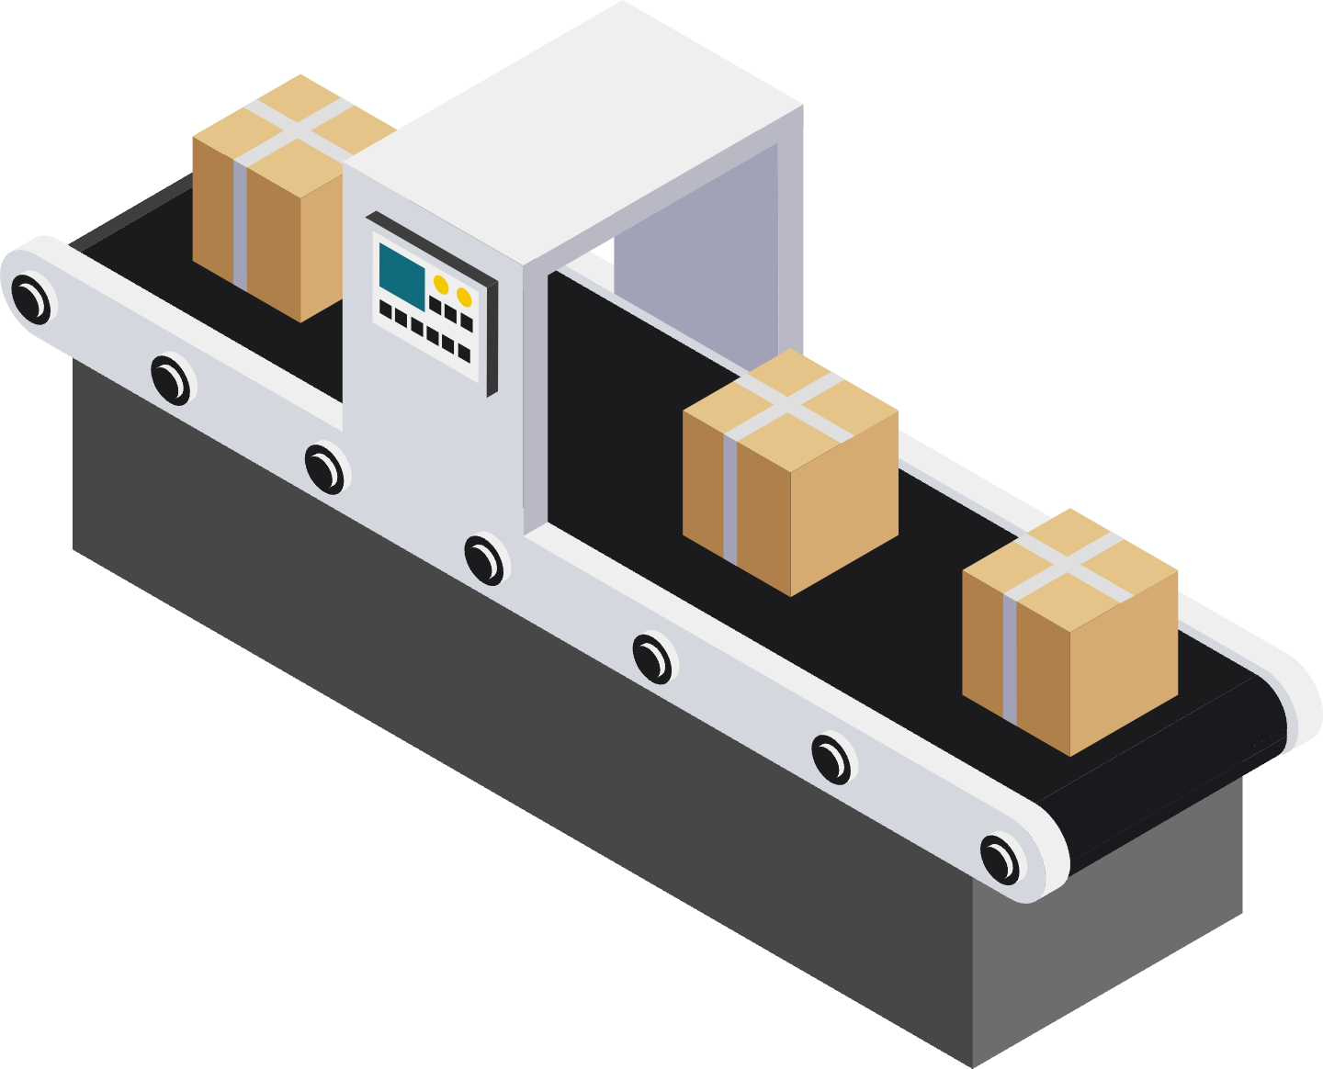
2. Order Fulfillment Verification
RFID AUTOMATION SOLUTIONS
Automated content verification without manual staging and unboxing
Order
Packaging Details
Item
Quantity
Order to delivery timing
Pickwave
Best in Class
Verify Without Ever Opening
Orchestrated read event with controlled read zones leveraging sensors and imagers
Item Level Visibility
Content verification without human intervention
Pack Validation
Published to integrated ERP/WMS
Order Verification
Instant cross-check and alarming capability
Alarming for incorrect product and quantity
Content Verification without opening the box
Automated aggregation of individual items within the parent container

Slide 15
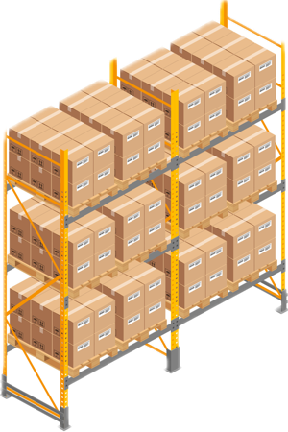
3. Inventory Management
RFID AUTOMATION SOLUTIONS
End-to-end inventory visibility with automated cycle counting in minutes
Best in Class
Industry Leading Inventory Management
Fastest Cycle Counting: Cycle count data captured in minutes instead of days
Automated Cycle Counting
Confidence in your on-hand inventory
Realtime Inventory Overview
Know where your products are and when they move
Product Aging
Understand individual asset journey through facility
Most Accurate Locationing: Direct operator to the right location the first time
Identify Significant Variation: Compare found to expected to prioritize problem-solving

Slide 16
4. Returnable Container Tracking
RFID AUTOMATION SOLUTIONS
Asset Visibility Across Suppliers, Manufacturers, Distributors, and Customers
Location
Inventory
WIP Status
Utilization
Asset History
Storage Location
Production Location
Never Lose an Asset
Best in Class
Serialized License Plate
For returnable and capital asset tracking
Reducing Waste
Fully automated monitoring of inventory, health, aging, and location with no human intervention
Production Reporting
Realtime work center health and WIP status
Differentiate by asset type with unique DNA
Asset utilization and aging report with asset history traceability

Slide 17
5. Shipment Verification
RFID AUTOMATION SOLUTIONS
Automated Shipping and Receiving Tracking
Item
Quantity
Status
Work Center History
Availability
Equipment Effectiveness
Read Only What You Need
Best in Class
Automated Verification
Automated tracking and verification for trailer loading and unloading interaction
Item Level Visibility
Track and verify shipments to the item level
Status Feedback
Shipment and receipt alarming with status monitoring
Industry-leading accuracy with controlled read zone behavior
Proprietary approach to managing reads so that only actual transactions are reported
Sub-second event alarming with efficient and fast publishing

Slide 18
SLSVIEW Architecture
RFID AUTOMATION SOLUTIONS
18

Slide 19
SLSVIEW Software Suite
RFID AUTOMATION SOLUTIONS
Applications
Asset Management
SLSVIEW Mobile
Microsoft Service Bus
Supply Chain Integration
Automated Asset Collection
SLSVIEW Print
SLSVIEW Cloud
Print with RFID
Order Fulfillment Verification
Inventory Management
Returnable Container Tracking
Shipment Verification
SLSVIEW
Hub
Data Warehouse
Shipment Verification
SLSVIEW Capture Windows
ERP Applications
MES Applications
Shipment Verification
SLSVIEW Capture Linux

Slide 20
RFID AUTOMATION SOLUTIONS
SLSVIEW Deployment
Business Requirements
Scope of Work Definition
Install Solution
Connect Solution
Integrate
Solution
Validate Solution
Transition to Sustain
Start
Purchase
Week 1
Week 4
Week 8
Week 12
Complete

Slide 21
ROI Achieved with SLSVIEW
RFID AUTOMATION SOLUTIONS
21

Slide 22
RFID AUTOMATION SOLUTIONS
Case Study
Inventory Management with SLSVIEW
How much is it costing you to cycle count daily?​
Building Technologies Company
Challenges
Benefits
Ask: Reduce 1,000 lost pieces of inventory per month (~$200 / piece)
Results:
$3,564,000 in annual savings
95% reduction in lost inventory​
4-month ROI on ~$1M initial investment
Chargeback reduction of $75,000/yr​
Now implementing dealership receipt verification programs
High cost + low availability of human labor
90%+ reduction in labor requirements
Lost inventory (85-95% inventory accuracy)
99%+ accuracy in a fraction of the time
Unknown product locations within facility
Product locations at the bay level
Lost sales due to stockouts
Optimal stocking levels = maximized sales
22

Slide 23
Thank you

Slide 24
Appendix
RFID AUTOMATION SOLUTIONS
24

Slide 25
RFID AUTOMATION SOLUTIONS
SLSVIEW Hub
Host System
Built with GS1 Standards
SLSVIEW Hub
GS1 EPC Information Services (EPCIS)
GS1 EPC Tag Data Standard
GS1 Core Business Vocabulary (CBV) Standard
SLSVIEW
Portal
Mobile
Tunnel
Tabletop
Handheld

Slide 26
Workflow Example: Shipment Verification
RFID AUTOMATION SOLUTIONS
26

Slide 27
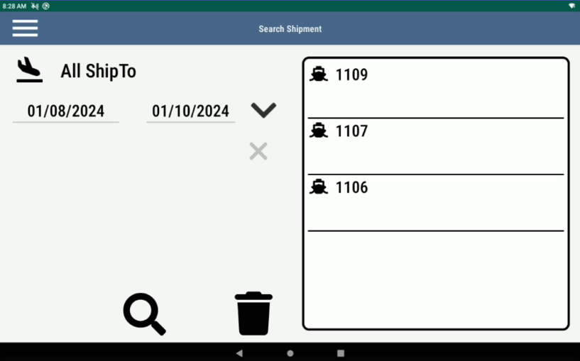
Shipment Verification
RFID AUTOMATION SOLUTIONS
Automated Shipping and Receiving Tracking
Print with Select Shipment by order
Pick the order to ship

Slide 28
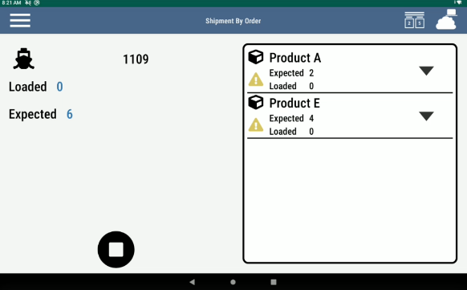
Shipment Verification
RFID AUTOMATION SOLUTIONS
Automated Shipping and Receiving Tracking
Print with Select Shipment by order
Pick the order to ship
Ability to pick order of different parts and different quantities

Slide 29
Shipment Verification
RFID AUTOMATION SOLUTIONS
Automated Shipping and Receiving Tracking
Print with Select Shipment by order
Pick the order to ship
Ability to pick the order of different parts and different quantities
Loaded quantity updates as tagged items are read by the reader

Slide 30
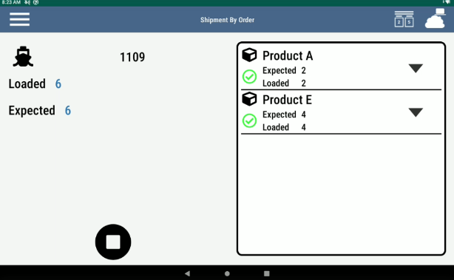
Shipment Verification
RFID AUTOMATION SOLUTIONS
Automated Shipping and Receiving Tracking
Print with Select Shipment by order
Pick the order to ship
Ability to pick the order of different parts and different quantities
Loaded quantity updates as tagged items are read by the reader
Checkbox appears when an item reaches the exceeded limit

Slide 31
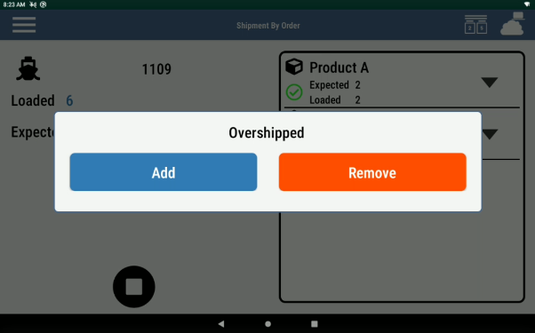
Shipment Verification
RFID AUTOMATION SOLUTIONS
Automated Shipping and Receiving Tracking
Print with Select Shipment by order
Pick the order to ship
Ability to pick the order of different parts and different quantities
Loaded quantity updates as tagged items are read by the reader
Checkbox appears when an item reaches the exceeded limit
A red light and audible sensor turns on when an item is read that doesn’t belong to the order

Slide 32
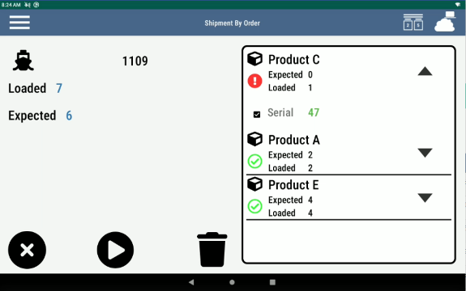
Shipment Verification
RFID AUTOMATION SOLUTIONS
Automated Shipping and Receiving Tracking
Print with Select Shipment by order
Pick the order to ship
Ability to pick the order of different parts and different quantities
Loaded quantity updates as tagged items are read by the reader
Checkbox appears when an item reaches the exceeded limit
A red light and audible sensor turns on when an item is read that doesn’t belong to the order
User can remove the incorrect item by selecting it and clicking “X” button

